Slide 1
Right Kitchen
Revolutionizing Kitchen Management
RK Dec ,2024

Slide 2
Overview
Introduction
Identifying Items
Last Used Date
Item-Based Weight Propagation
Expiry Item Notification
Hologram Display or Camera
Mobile App Integration
Manual Correction
Conclusion
Q&A

Slide 3
Introduction
Welcome to Right Kitchen, where innovative technology meets the heart of your home. Right Kitchen is a cutting-edge kitchen management system designed to revolutionize the way you organize, monitor, and optimize your kitchen inventory and processes.
In today's fast-paced world, efficient kitchen management is essential for maintaining a healthy lifestyle, reducing food waste, and saving time and money. With Right Kitchen, we aim to address these challenges by providing a comprehensive solution that empowers users to effortlessly manage their kitchen with precision and ease.

Slide 4
Identifying Items: Right Kitchen employs advanced technology to accurately identify items within your kitchen inventory. Whether it's groceries, ingredients, or household essentials, our system ensures that you always know exactly what you have on hand.
Last Used Date Tracking: Say goodbye to forgotten items languishing in the back of your pantry. Right Kitchen keeps track of the last used date for each item, allowing you to prioritize usage based on freshness and minimize waste.
Item-Based Weight Propagation: Understanding the weight propagation of items is crucial for efficient meal planning and inventory management. Right Kitchen intelligently calculates item propagation based on weight, ensuring accurate tracking and usage estimation.
Expiry Item Notification: Never let expired items go unnoticed again. Right Kitchen proactively notifies you when items are nearing their expiration date, helping you avoid food spoilage and maintain a safe and healthy kitchen environment.

Slide 5
Hologram Display or Camera Integration: Experience the future of kitchen management with our innovative hologram display or camera integration. Easily access inventory information and interact with your kitchen in new and exciting ways.
Mobile App Convenience: With our intuitive mobile app, managing your kitchen has never been easier. Scan grocery bills, automatically calculate item propagation, and make manual corrections on the go—all from the palm of your hand.

Slide 6
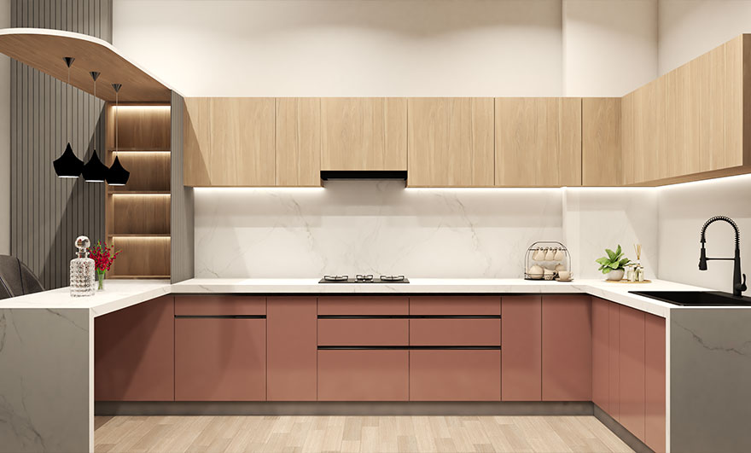
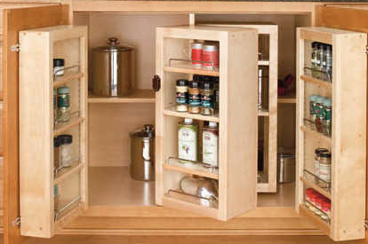
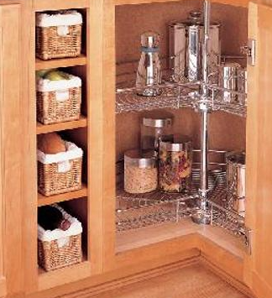
Normal Modern Kitchen

Slide 7
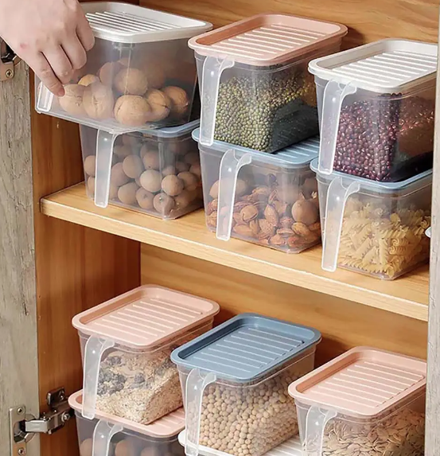
Right Kitchen – Modal 1
Right Kitchen

Slide 8
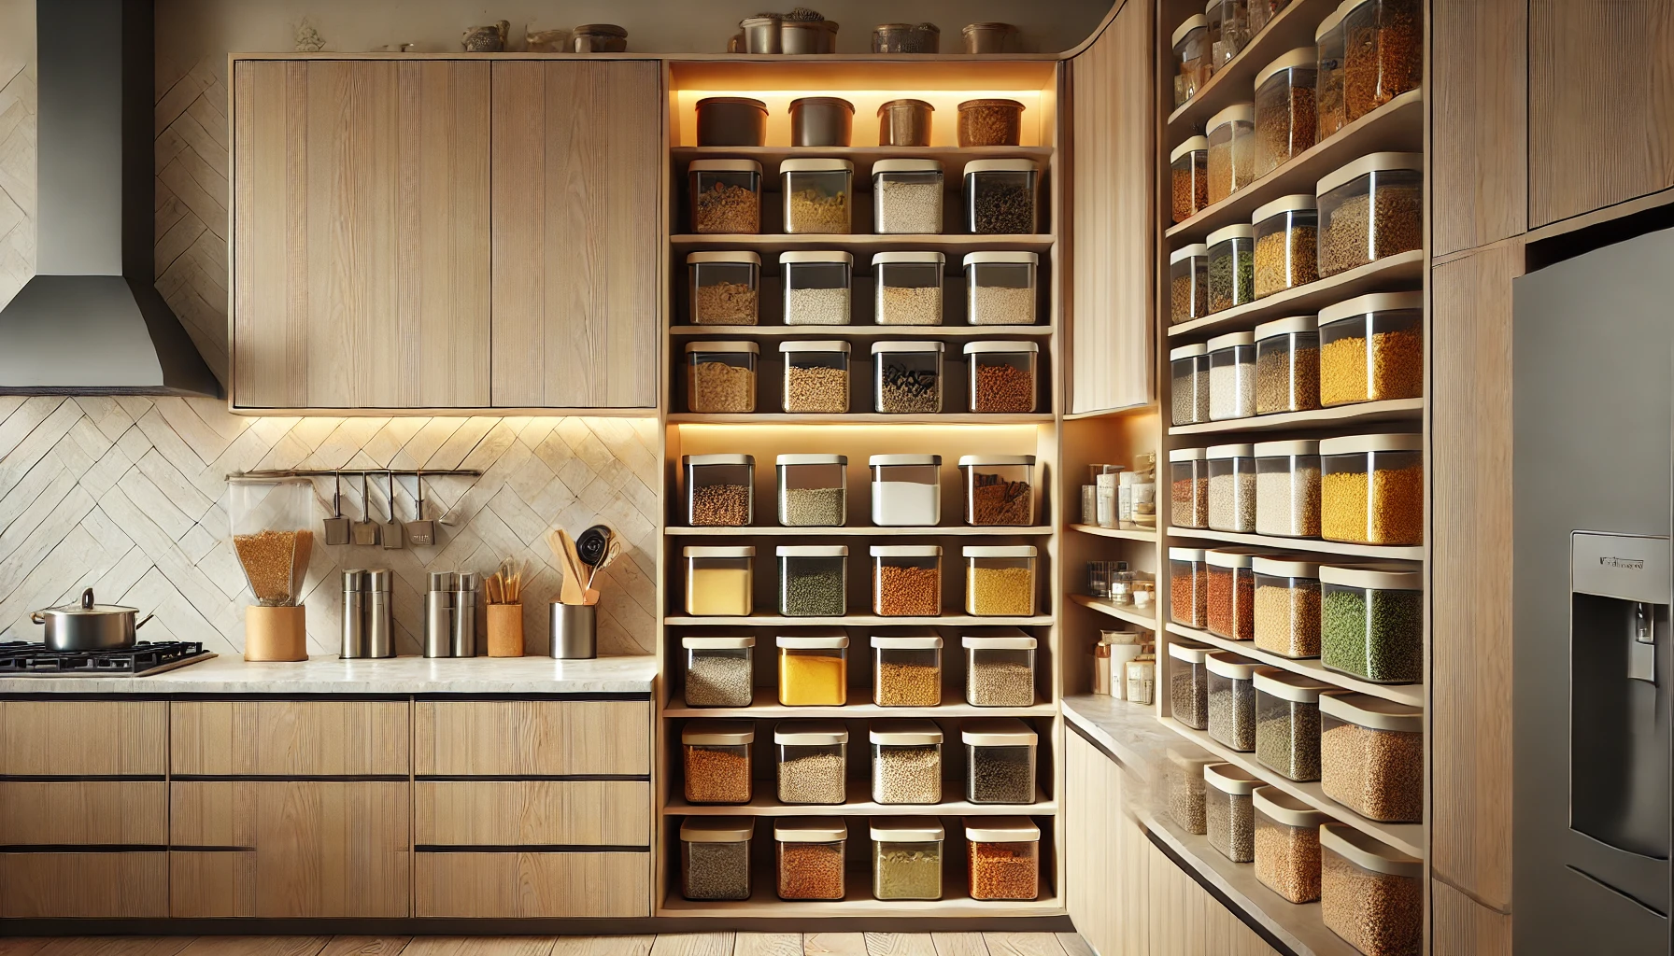
Right Kitchen – Modal 2
Right Kitchen

Slide 9
Components and Costs
# | Component | Quantity | Cost (Approx.) | Total (Approx.)
1 | Arduino Mega 2560 | 1 | ₹ 1,500 | ₹ 1,500
2 | HX711 Load Cell Amplifier | 35 | ₹ 200 | ₹ 7,000
3 | Load Cells (Varied Capacities): | 35 | Varies (see below) | ₹9,000-₹12,000
4 | HC-05/HC-06 Bluetooth Module | 1 | ₹400-₹500 | ₹ 500
5 | Power Supply (5V/12V) | 1 | ₹1,000-₹1,500 | ₹ 1,500
6 | Cables, Connectors, Breadboards | N/A | ₹500-₹1,000 | ₹ 1,000
7 | PCB or Custom Circuit Board | 1 | ₹2,000-₹5,000 | ₹ 3,500
8 | Enclosure (Custom Box) | 1 | ₹2,000-₹3,000 | ₹ 2,500
Load Cell Costs (Varied Capacities)
10 kg load cells (5 units): ₹300-₹500 each.
5 kg load cells (10 units): ₹250-₹400 each.
1 kg load cells (15 units): ₹200-₹300 each.
0.5 kg load cells (5 units): ₹150-₹250 each.
Estimated Total Cost: ₹20,000 to ₹30,000.

Slide 10
Conclusion
Right Kitchen isn’t just a kitchen system—it’s a lifestyle enhancement. By embracing advanced technology and seamless integration, it empowers you to take control of your kitchen with ease, precision, and efficiency.
Thank You! Let’s revolutionize the way we manage our kitchens.

